Slide 1

Freiburg Unemployment Rate Analysis
Presented By : Anita Gashi

Slide 2

Table of Content
Purpose Statement (What are we talking about):
Tell the story with data
Conclusion

Slide 3
Objective
Identify the reasons of hight rate of unemployment
Identify which district in city has higher rate of unemployment during which years
Identify if there are education or age factors that contribute to unemployment

Slide 4
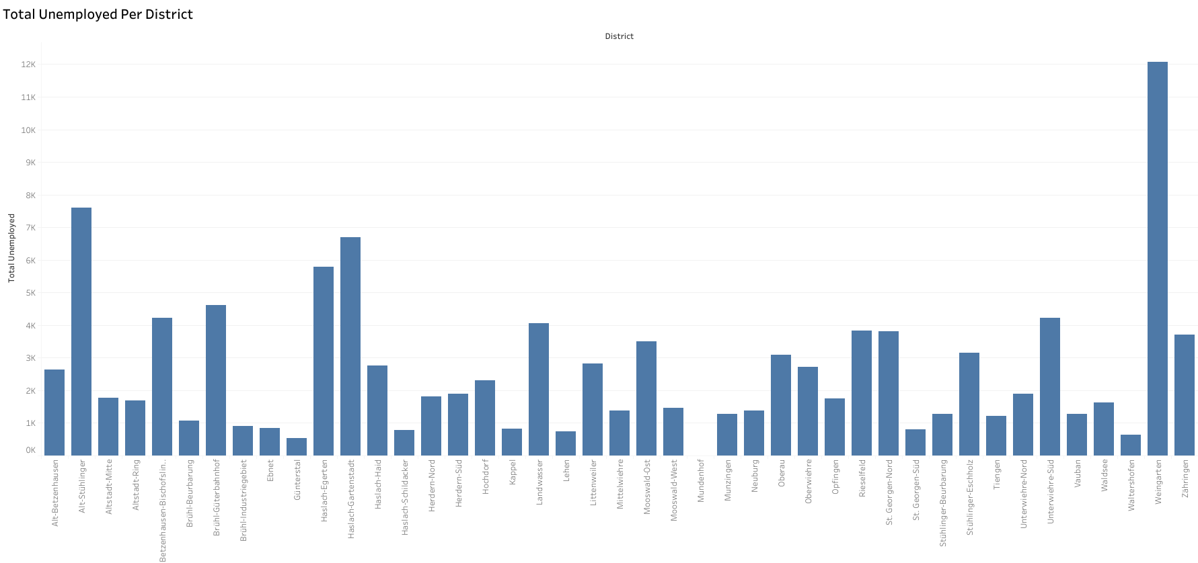

Slide 5
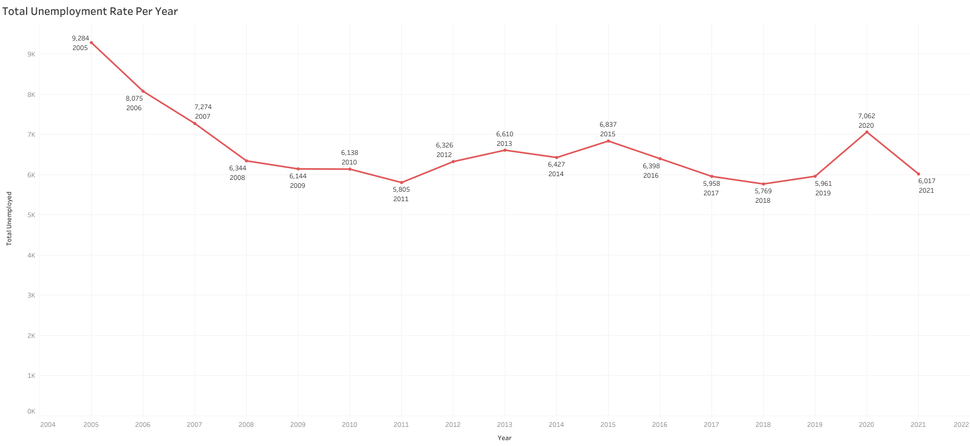

Slide 6
The year with highest unemployment rate in Freiburg was 2005, this because it was a crisis economy in Germany that time
We can also see that in 2020 the rate was too hight compare to others , this is because of Corona Virus , which has affected bad not only in Germany but all ower the world.
The District with highest Rate of unemployment ist WeinGarten during all Years 2005-2021 , this is because this district has more criminality cases and that could cause high rate of unemployment

Slide 7
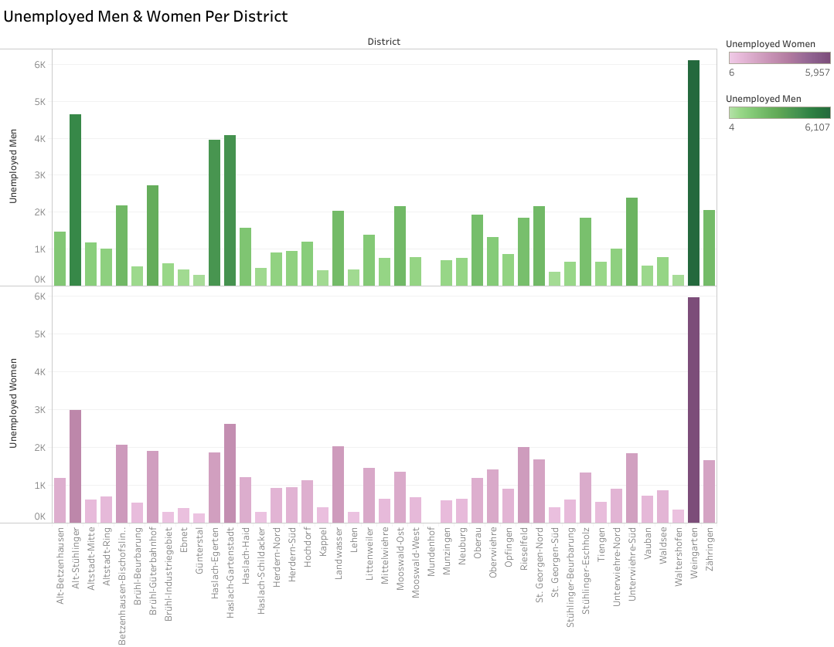
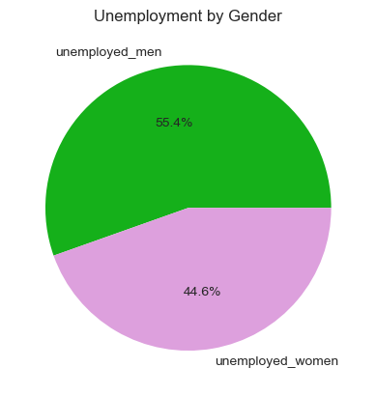

Slide 8
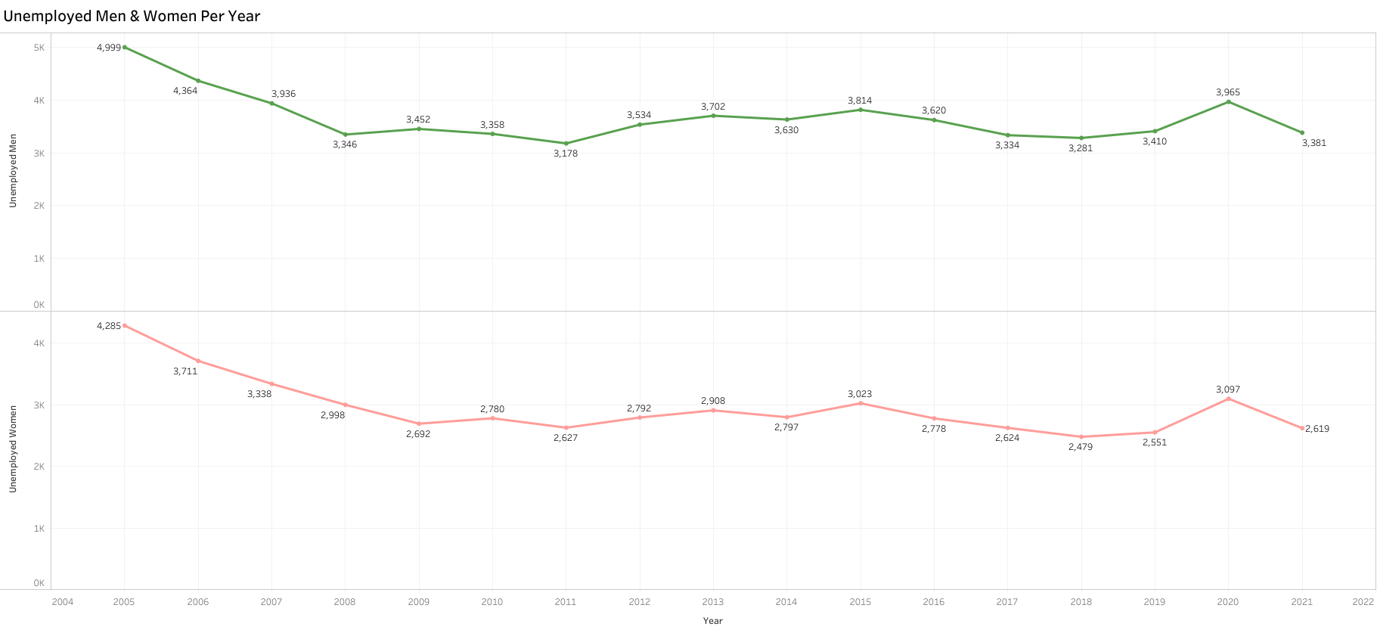

Slide 9

The rate of unemployed men is higher than women with 55.4% for men and 44.6% women
Even in two genders the rate was higher in 2005 and 2020

Slide 10
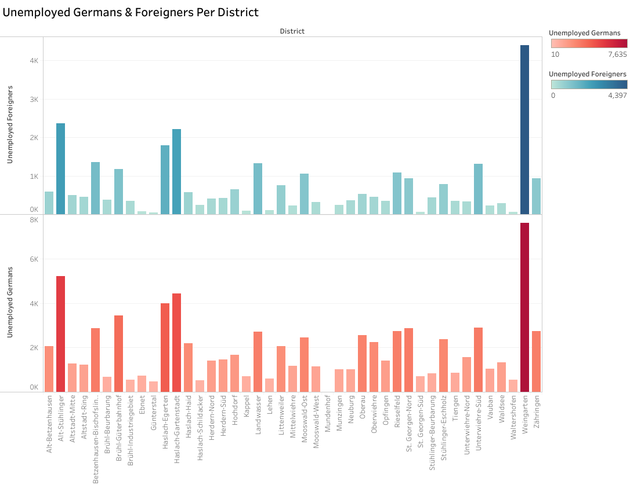
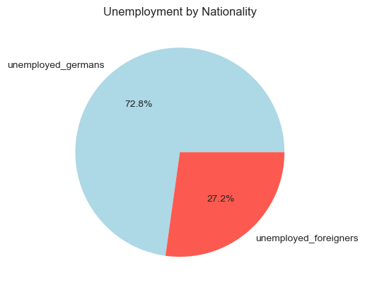

Slide 11
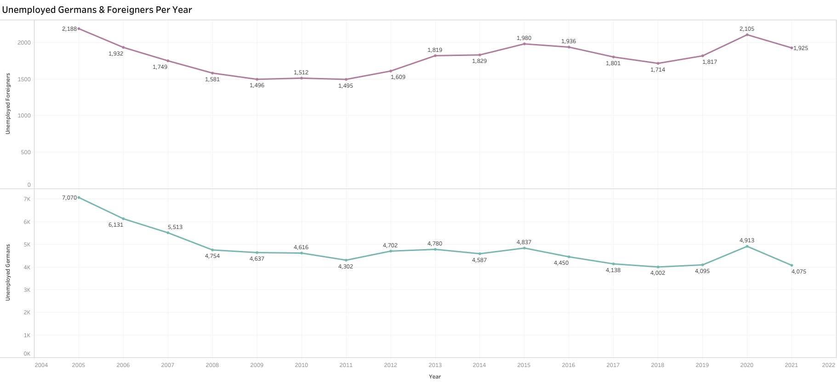

Slide 12


Conclusion
Germans have hight rate of unemployment in this city , but this is because here live more Germans than foreigners and that increase the rate of unemployment for German people

Slide 13
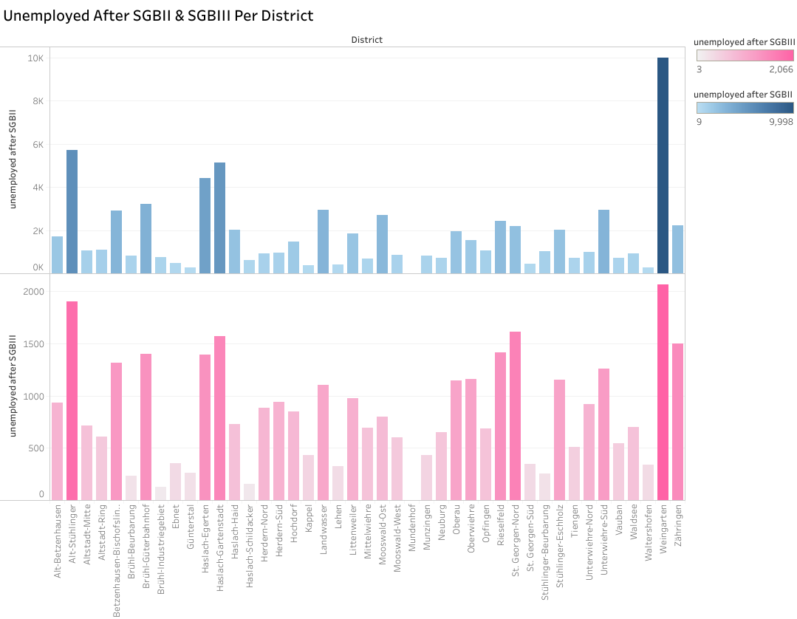
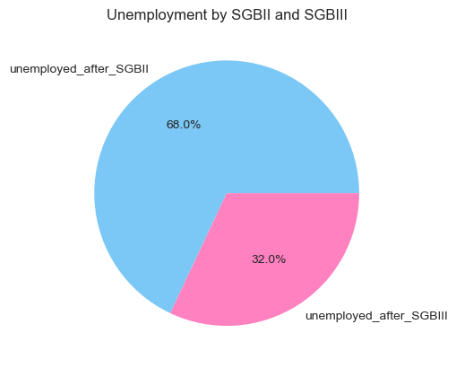

Slide 14
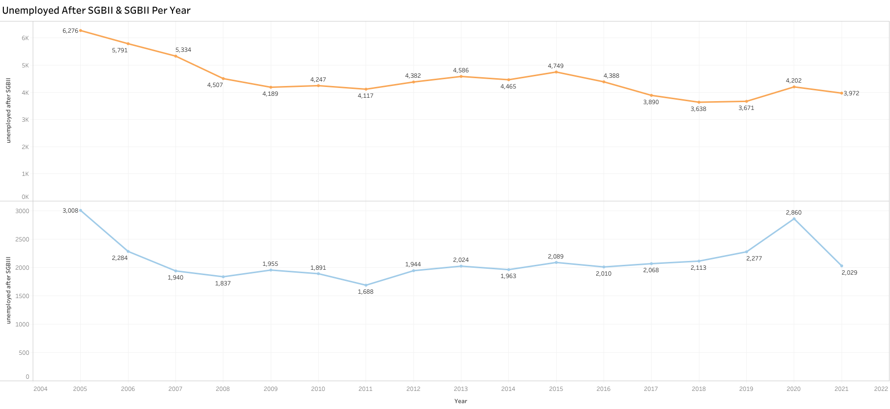

Slide 15

Conclusion
Highest rate of unemployment was after SGBII book than SGBIII and there are some reasons :
The SGB II, also known as "Arbeitslosengeld II" deals with social assistance and support for individuals and families who are unable to cover their basic living costs. It focuses on unemployment benefits and the provision of means-tested social benefits.
The SGB III focuses on active labor market policies and the regulation of employment and training in Germany. It aims to facilitate employment opportunities, promote vocational training, and enhance workforce integration

Slide 16
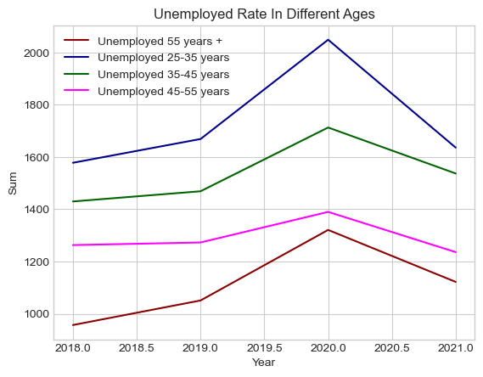
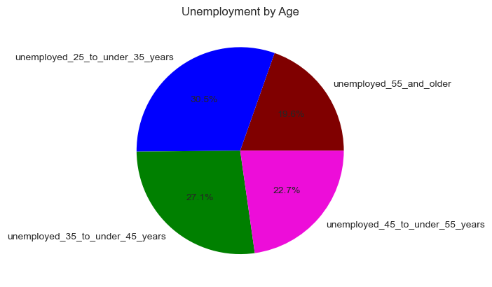

Slide 17
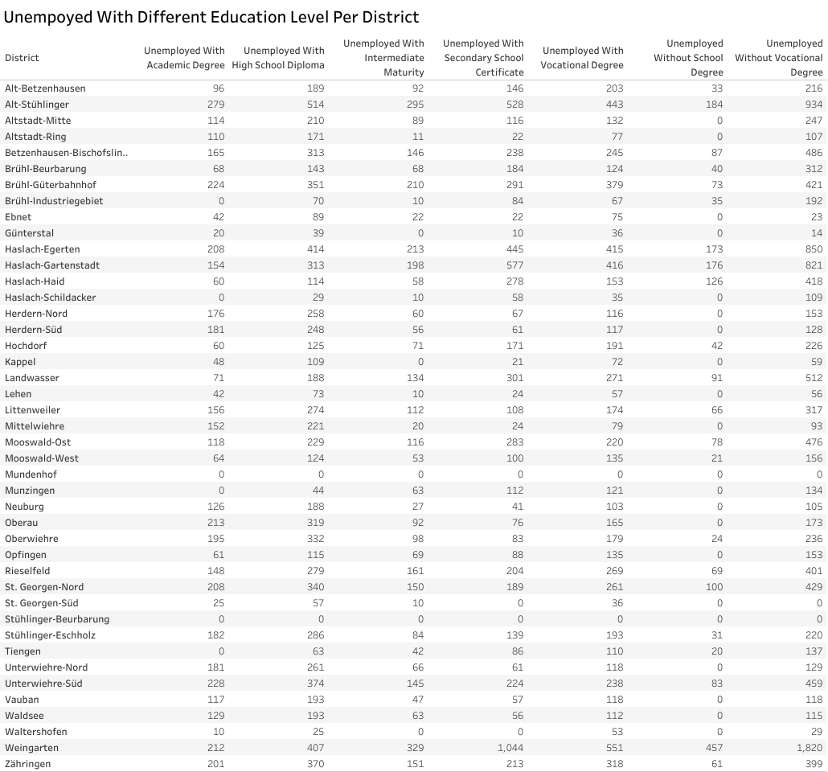

Slide 18

Conclusion
The hight rate of unemployment is at young age and here are some reasons of this :
Lack of work experience: Young people entering the job market often have limited work experience, which can make it more challenging for them to compete with older, more experienced candidates.
Education and qualifications: Young people may still be in the process of acquiring higher education or vocational training, which can create a temporary gap between completing their studies and finding suitable employment
Networking and connections: Older individuals often have more extensive professional networks built over the years, which can provide them with better access to job opportunities. Young people, who are just starting their careers, may have limited networks and may face challenges in finding suitable job openings.

Slide 19
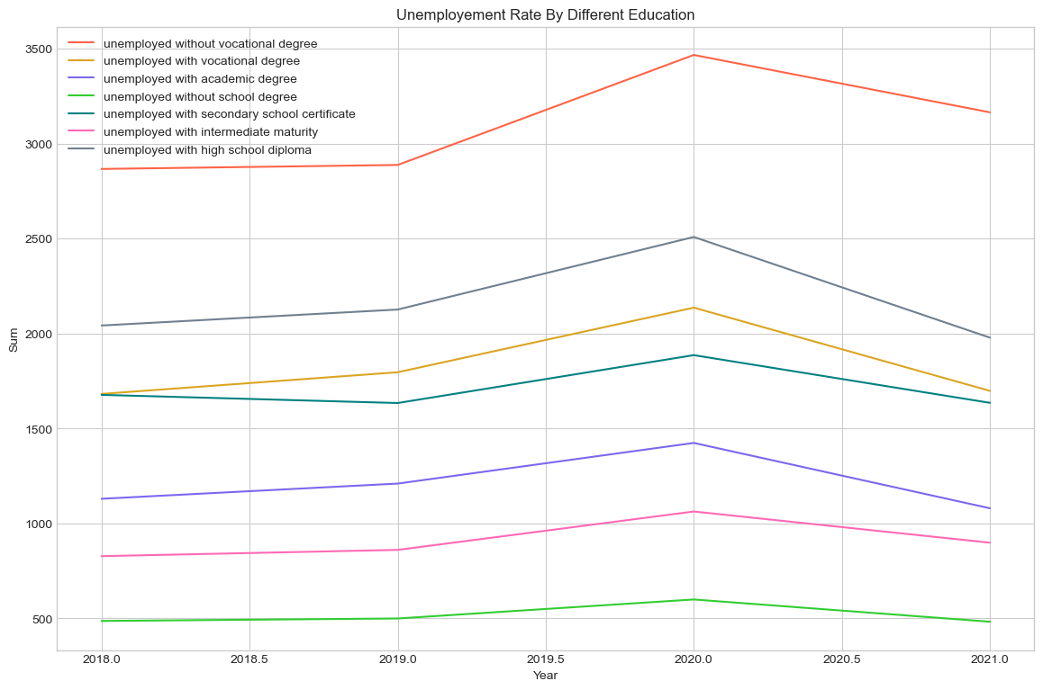
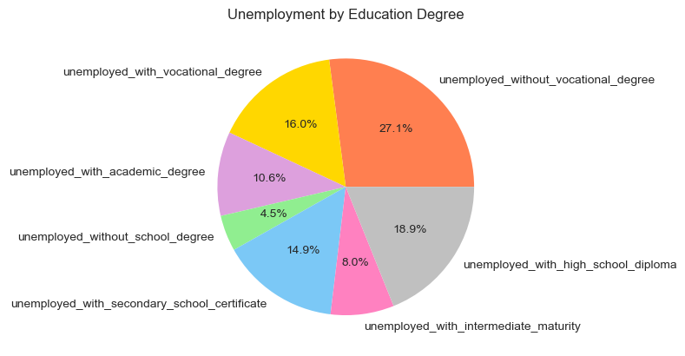

Slide 20

Conclusion
Highest unemployment rate have people without vocational degree and this is why could be that :
Industry-specific demand: Certain industries may place a higher emphasis on vocational training and prefer individuals with specific skills acquired through vocational education.
Skills and qualifications: Vocational degrees often provide practical, job-specific skills that are directly applicable to a particular occupation or industry.

Slide 21
Conclusion
My conclusion is that there are many factors that contribute to unemployment rate in a city , which are :
Regional Factors
Education Factors
Age Factors

Slide 22

THANK YOU !

